Slide 1
Python for chemical engineers
Getting Started
Paul Adamson, PhD
paul.adamson.01@gmail.com
October 23, 2019

Slide 2
Outline
Why Python?
Setting up python (Anaconda Distribution)
Demos
Getting started
Plotting data
McCabe-Thiele
Along the way
Basic and intermediate Python syntax and methods
Interactive notebooks (Jupyter Notebook)
Modules and packages (math, numpy, scipy, pandas, matplotlib)
Getting and running the demo’d notebooks

Slide 3
A note Before We Get Started
If you are watching this live (or simulated live)…
Sit back and relax
Think of this as a demo, not a course
Later, you can…
Download the demo’d notebooks
Access the recording on AIChE Academy
Pause the recording as you go through the demo

Slide 4
Why Python?
Fastest growing computer programming language
Vibrant open source community
Simple yet dynamic syntax
Interoperable with other languages
A lot of capability “baked in”
Giant scientific python (SciPy) ecosystem
See Milan Curcic’s July 24, 2019, AIChE VLS webinar “Should I Py or Should I Fortran?”
Also see “The Case For Python in Scientific Computing,” a summary of two PyCon2017 Keynotes: https://www.datacamp.com/community/blog/python-scientific-computing-case
PYPL PopularitY of Programming Language Index (http://pypl.github.io/PYPL.html).

Slide 5
Anaconda Distribution
Perhaps the easiest way to get started with Python
Primarily developed for data science (also supports R), but widely applicable
Free, easy-to-install package manager
Environment manager (conda, but also supports pip)
Collection of 1,000+ open source packages with free community support
Platform-agnostic: you can use it on Windows, macOS or Linux

Slide 6
Installing Anaconda Distribution
Install instructions: https://docs.anaconda.com/anaconda/install/
Download: https://www.anaconda.com/distribution/#download-section
Graphical (Windows, macOS, and Linux) or command-line (macOS) installers
$ bash ~/Downloads/Anaconda3-2019.10-MacOSX-x86_64.sh

Slide 7
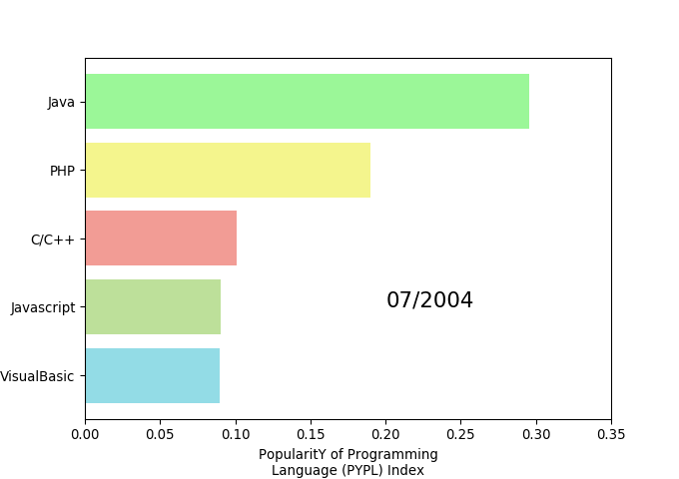
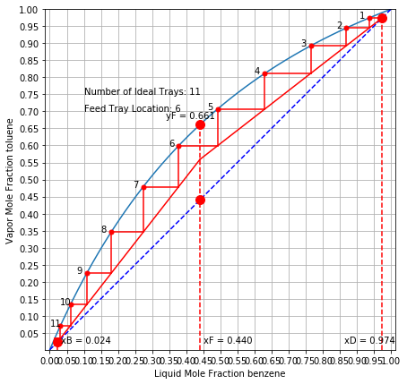
Demos

Slide 8
Getting the Slides and Demos
Github
Download: https://github.com/padamson/python_cheme/archive/master.zip
Clone
$ git clone https://github.com/padamson/python_cheme.git

Slide 9
Acknowledgements
http://jckantor.github.io/CBE20255/ - CBE20255 Introduction to Chemical Engineering Analysis demonstrates the use of mass and energy balances for the analysis of chemical processes and products.
http://www.learncheme.com – Educational resources for chemical engineering hosted at University of Colorado Boulder.
http://pypl.github.io/PYPL.html - The PYPL PopularitY of Programming Language Index is created by analyzing how often language tutorials are searched on Google.

